Slide 1
DATA ANALYSIS
INTEGRATING DATA – MAP OVERLAY

Slide 2
INTEGRATING DATA – MAP OVERLAY
Map Overlay: It is an important technique for integrating data derived from various sources and perhaps is the basic key function in GIS data analysis and modelling surfaces.
Map Overlay is a process by which it is possible to take two or more different thematic maps of the same area and overlay them on top of the other to form a composite new layer.
This technique is used for the overlay of vector data on a raster background image overlays where new spatial data sets are created involving the merger of data from two or more input data layers to create a new output data layer.

Slide 3
TYPES OF MAP OVERLAY
Map Overlay: Vector Overlay and Raster Overlay
Vector overlay: To create topology for a new data layer produced as a result of the overlay process, the intersections of lines and polygons from the input layers need to be calculated using geometry.
The overlay of two or more data layers representing simple spatial features results in a more complex output layer. This will contain more polygons, more intersections and more line segments than either of the input layers.

Slide 4
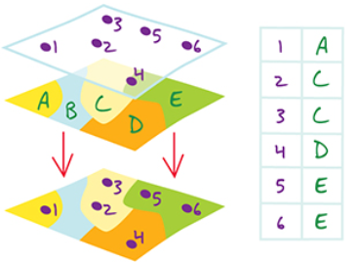
VECTOR OVERLAY
POINT-IN-POLYGON: A spatial operation in which points from one feature dataset are overlaid on the polygons of another to determine which points are contained within the polygons.

Slide 5
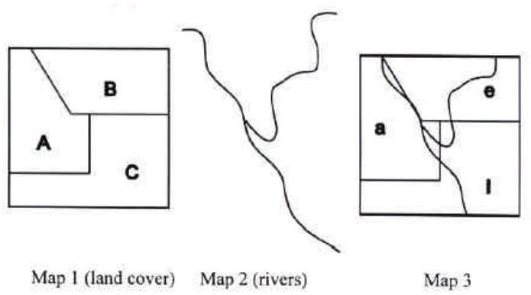
VECTOR OVERLAY
LINE-IN-POLYGON: It is a spatial operation in which lines in one coverage are overlaid with polygons of another coverage to determine which lines, or portions of lines, are contained within the polygons. Polygon attributes are associated with corresponding lines in the resulting line coverage.

Slide 6
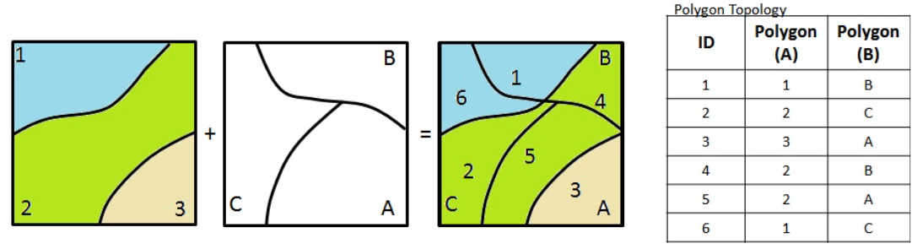
VECTOR OVERLAY
POLYGON-IN-POLYGON: The process of overlapping polygons from two input layers to create new polygons in an output layer. The result of a Polygon-on-Polygon overlay is an output layer containing new polygons with merged attributes.
GIS operation (vector overlay) where polygons on one dataset are overlaid onto polygons of another to determine location of different polygons.

Slide 7
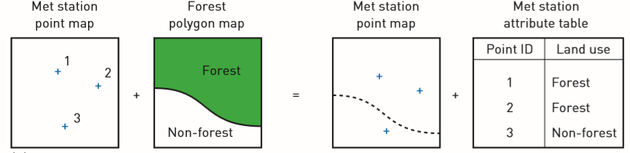
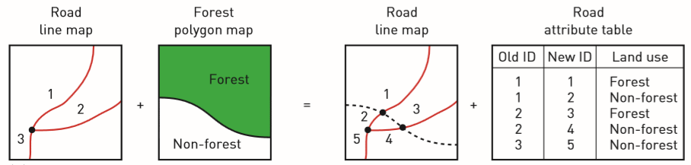
POINT IN POLYGON
LINE IN POLYGON

Slide 8
VECTOR OVERLAY
Point-in-polygon overlay is used to find out the polygon in which a point falls. In the Happy Valley GIS meteorological stations are represented as points and land use as polygons.
Using point-in-polygon overlay on these vector data layers it is possible to find out in which land use polygon each meteorological station is located.

Slide 9
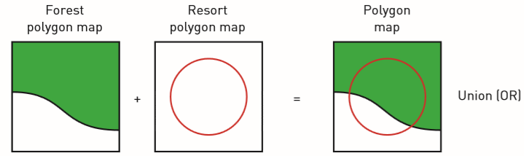
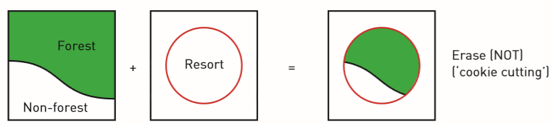
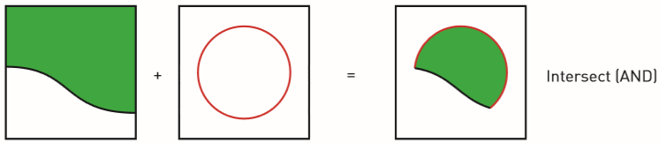
POLYGON IN POLYGON

Slide 10
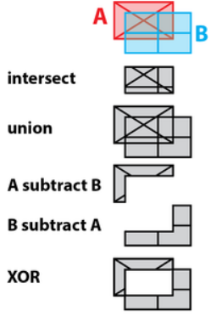
VECTOR OVERLAY
Polygon Overlay Functions:

Slide 11
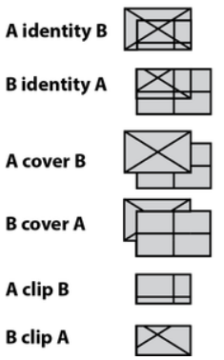
VECTOR OVERLAY
Polygon Overlay Functions:
http://wiki.gis.com/wiki/index.php/Overlay

Slide 12
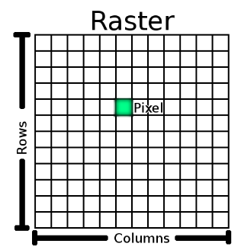
RASTER OVERLAY
Raster Data: A raster dataset is composed of rows (running across) and columns (running down) of pixels (also know as cells). Each pixel represents a geographical region, and the value in that pixel represents some characteristic of that region.

Slide 13
RASTER OVERLAY
Raster overlay involves two or more different sets of data that derive from a common grid. The separate sets of data are usually given numerical values. These values then are mathematically merged together to create a new set of values for a single output layer.
Raster overlay is often used to create risk surfaces, sustainability assessments, value assessments, and other procedures.

Slide 14
RASTER OVERLAY
In the raster data structure everything is represented by cells – a point is represented by a single cell, a line by a string of cells and an area by a group of cells.
The methods of performing overlays are different from those in vector GIS. Raster map overlay introduces the idea of map algebra or ‘mapematics’

Slide 15
RASTER OVERLAY
Using map algebra input data layers may be added, subtracted, multiplied or divided to produce output data.
Mathematical operations are performed on individual cell values from two or more input layers to produce an output value.
The meteorological stations are represented in a raster data layer where the value of ‘1’ has been given to cells containing the stations. Roads are coded ‘2’ in the roads raster layer and cells have been linked to create chains.

Slide 16
RASTER OVERLAY
Each cell in the land use layer has a value reflecting the type of land use present. Settlement is coded ‘1’, water ‘2’, agricultural land ‘4’ and forestry ‘5’. The resort area has been given a value ‘10’. On all data layers ‘0’ is the value given to cells that do not contain features of interest.

Slide 17
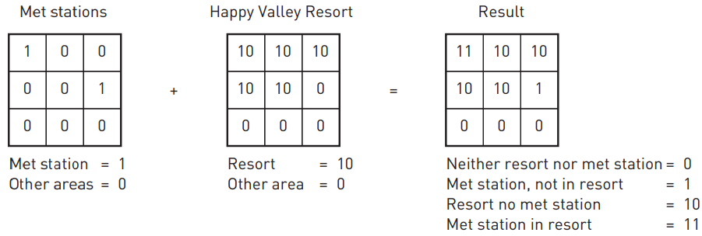
RASTER OVERLAY
Point-in-Polygon using addition operation

Slide 18
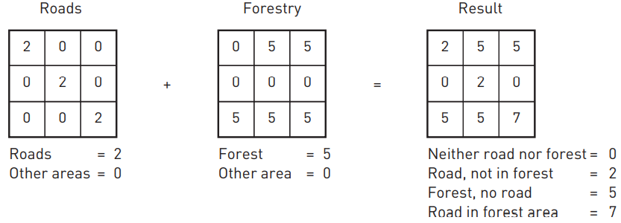
RASTER OVERLAY
Line-in-Polygon using addition operation

Slide 19
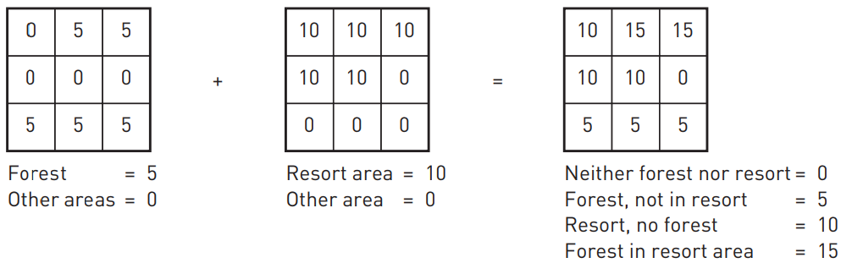
RASTER OVERLAY
Polygon-on-Polygon using addition operation

Slide 20
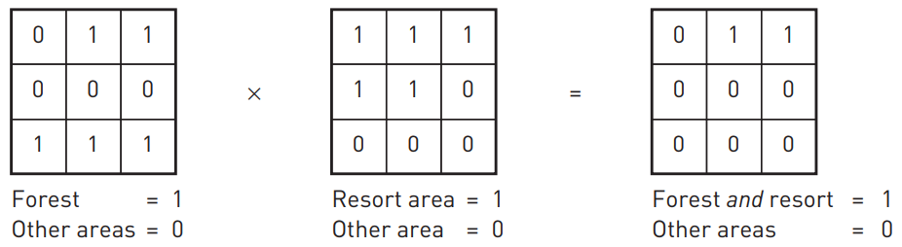
RASTER OVERLAY
Polygon-on-Polygon using multiplication operation

Slide 21
SPATIAL INTERPOLATION
Spatial interpolation is the procedure of estimating the values of properties at unsampled sites within an area covered by existing observations.
The role for interpolation in GIS is to fill in the gaps between observed data points.
A common application of interpolation is for the construction of height contours.
Contours on a topographic map are drawn from a finite number of height observations taken from surveys and aerial photographs.
The height of the land surface between these points is estimated using an interpolation method and represented on a map using contours.

Slide 22
Classification of Interpolation Methods
Global interpolation methods: It apply a single mathematical function to all observed data points and generally produce smooth surfaces.
Local methods apply a single mathematical function repeatedly to small subsets of the total set of observed data points and then link these regional surfaces to create a composite surface covering the whole study area

Slide 23
Classification of Interpolation Methods
Exact methods of point interpolation: It honour all the observed data points for which data are available.
This means that the surface produced passes exactly through the observed data points, and must not smooth or alter their values.
Exact methods are most appropriate when there is a high degree of certainty attached to the measurements made at the observed data points.

Slide 24
Classification of Interpolation Methods
Approximate methods of interpolation do not have to honour the observed data points, but can smooth or alter them to fit a general trend.
Approximate methods are more appropriate where there is a degree of uncertainty surrounding the measurements made at the sample points.

Slide 25
Classification of Interpolation Methods
Gradual and abrupt interpolation methods are distinguished by the continuity of the surface produced.
Gradual methods produce a smooth surface between sample points whereas abrupt methods produce surfaces with a stepped appearance. Terrain models may require both methods as it may be necessary to reproduce both gradual changes between observed points, for example in rolling terrain, and abrupt changes where cliffs, ridges and valleys occur.

Slide 26
Classification of Interpolation Methods
Deterministic methods of interpolation can be used when there is sufficient knowledge about the geographical surface being modelled to allow its character to be described as a mathematical function.
Unfortunately, this is rarely the case for surfaces used to represent real world features. To handle this uncertainty stochastic (random) models are used to incorporate random variation in the interpolated surface.

Slide 27
Interpolation techniques
Four of the most frequently used methods – Thiessen polygons, TIN, spatial moving average and trend surfaces
Thiessen polygons (or Voronoi polygons) are an exact method of interpolation that assumes that the values of unsampled locations are equal to the value of the nearest sampled point.
This is a local interpolator because the global characteristics of the data set exert no influence over the interpolation process.
It is also an abrupt method of interpolation as sharp boundaries are present between the interpolated polygons.

Slide 28
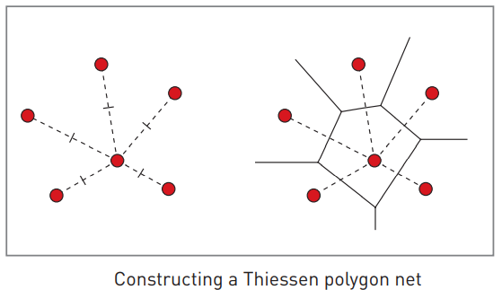
Interpolation techniques
Example for Thiessen polygons

Slide 29
Interpolation techniques
A triangulated irregular network or TIN is an elegant way of constructing a surface from a set of irregularly spaced data points. This method of spatial interpolation is often used to generate digital terrain models.
The TIN model is an exact interpolation method based on local data points. In this method adjacent data points are connected by lines to form a network of irregular triangles.

Slide 30
Interpolation techniques
The spatial moving average is perhaps the commonest interpolation method used by GIS.
It involves calculating a value for a location based on the range of values attached to neighbouring points that fall within a user-defined range.
This neighbourhood filter is passed systematically across the region of interest, calculating new interpolated values as it goes.

Slide 31
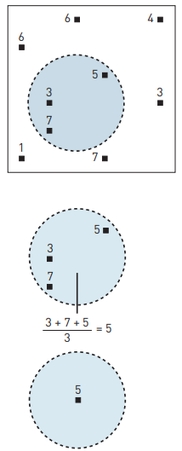
Interpolation techniques
Example: Spatial moving average in Vector GIS

Slide 32
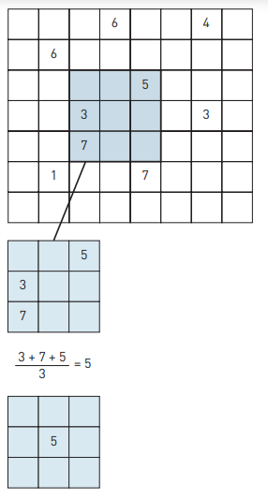
Interpolation techniques
Example: Spatial moving average in Raster GIS

Slide 33
Interpolation techniques
The trend surface method attempts to fit a mathematically defined surface through all the data points so that the difference between the interpolated value at a data point and its original value is minimized.
It is an example of an approximate and global interpolator. The method does not necessarily honour all of the data points but does use all the data points in its calculation.
It is a type of regression model that fits a surface through a three-dimensional set of data points (x,y,z) rather than fitting a line or curve through a two-dimensional set of data points (x,y).

Slide 34
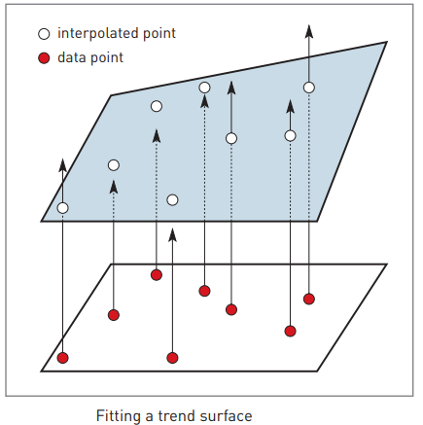
Interpolation techniques
Example: Trend Surface Method

Slide 35
ANALYSIS OF SURFACES
Surface analysis will depict surface conditions plotted from reported data or generated by computer models. Surface analyst in GIS generated the contour, slope, aspect, and hill shade maps.
Surface analysis involves several kinds of processing, including extracting new surfaces from existing surfaces, reclassifying surfaces, and combining surfaces.
To handle and analyze true three-dimensional data are limited.

Slide 36
ANALYSIS OF SURFACES
Despite these limitations, there are still many analysis functions in GIS that operate on surfaces.
These range from draping functions that allow the results of other analyses to be overlain on a surface, to slope and aspect calculation, and visibility analysis.
Slope is the steepness or gradient of a unit of terrain, usually measured as an angle in degrees or as a percentage.
Aspect is the direction in which a unit of terrain faces, usually expressed in degrees from north. These two variables are important for many GIS applications.

Slide 37
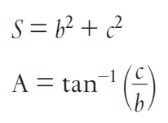
ANALYSIS OF SURFACES
In raster DTMs slope and aspect are calculated using a 3 × 3 window that is passed over a database to determine a ‘best fit tilted plane’ for the cell at the centre of the window. This allows the calculation of constants for the equation.
z = a + bx + cy
where z = height at the point of interest (the c entre of the window), (x,y) = co-ordinates of the point at the centre of the window, and a, b, c = constants.
Slope and aspect for the centre cell can then be calculated (S = slope, A = aspect) using the formulae:

Slide 38
ANALYSIS OF SURFACES
There are many other methods of calculating slope and aspect from a DEM including the neighbourhood method, quadratic surface method, best fit plane method and maximum slope method.
In the vector TIN model slope and aspect variables are usually calculated using a series of linear equations when the TIN is generated. The equations calculate the slope and aspect of the individual triangles formed by the TIN.
Slope and aspect may also be calculated as a first step to more complex terrain analysis. Parameters such as analytical hill shading, the rate of change of slope, convexity or curvature may be necessary for terrain visualization, landform analysis or classification.

Slide 39
ANALYSIS OF SURFACES
Analytical hillshading is a well established technique used to depict the general pattern of terrain in maps. It works by calculating the location of shadow and the amount of sun incident on the terrain surface when the sun is in a particular position in the sky.
Analytical hillshading can also be used to derive relative estimates of the amount of sunlight (incoming solar radiation) received by a particular slope or cell in a DEM at a particular time or across a specified time period. This can be useful in modelling snow melt, freezethaw cycles, rates of photosynthesis, suitability for certain crop types and yields from solar energy installations.

Slide 40
ANALYSIS OF SURFACES
Curvature describes the rate of change of slope and/or aspect.
Slope curvature can be calculated in plan or profile or a combination of both.
Profile curvature is the rate of change of slope relative to a linear or flat profile.
Negative curvature indicates a concave slope profile and positive curvature indicates a convex profile.
Plan curvature describes the rate of change of aspect relative to a given datum.

Slide 41
ANALYSIS OF SURFACES
Negative curvature indicates concave plan form (such as troughs and valleys) and positive curvature indicates convex plan form (such as spurs and ridges).
A knowledge of slope curvature is important for studies of slope forming processes and hydrology as it controls (and is, in turn, determined by) mass movement and runoff and flow rates.
Combinations of profile and plan curvature can be used to identify and extract features from a DTM such as peaks, passes, ridges and troughs. This can be an important tool in helping geomorphologists understand landscape form and process

Slide 42
ANALYSIS OF SURFACES
Visibility analysis: One of the common uses of terrain models is in visibility analysis, the identification of areas of terrain that can be seen from a particular point on a terrain surface.
This is used in a variety of applications ranging from locating radio transmitters and cellular communications (mobile phone) masts for maximum coverage to minimizing the impact of commercial forestry in protected areas.
The method for calculating a visibility surface is similar in both raster and vector GIS and in each case the results of analysis would be presented as a viewshed map or Zone of Visual Influence (ZVI).

Slide 43

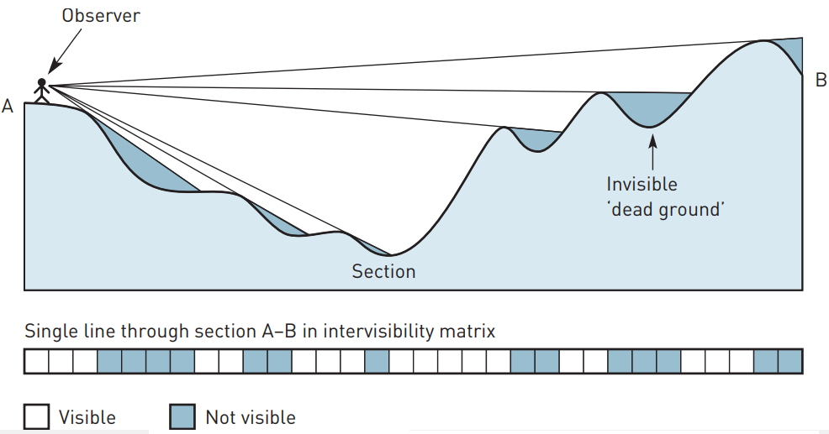
ANALYSIS OF SURFACES
This is a Boolean polygon map that indicates which areas of terrain are visible from the location of interest. This map may be more easily interpreted and understood by draping it over the top of a terrain surface for visualization.

